Slide 1
ai+learn
ai+come, ai+see, ai+Learn
Notes:
emily.zhong@berkeley.edu
https://twitter.com/i/moments/880688233641848832?lang=en
Paving the way for a new era of language learning
ai+come, ai+see, ai+Learn

Slide 2
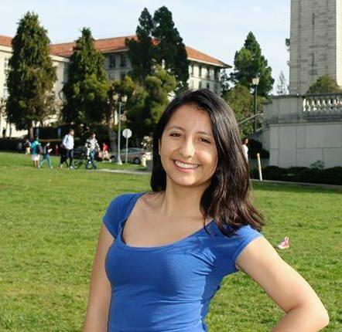






Nina
Sophomore
Tamil
Katherine
Senior
Español
Julie
Sophomore
中文
Kavya
Senior
Tamil
Notes:
cathleenjia@berkeley.edu
ababakanian@berkeley.edu
https://piktochart.com/blog/startup-pitch-decks-what-you-can-learn/

Slide 3

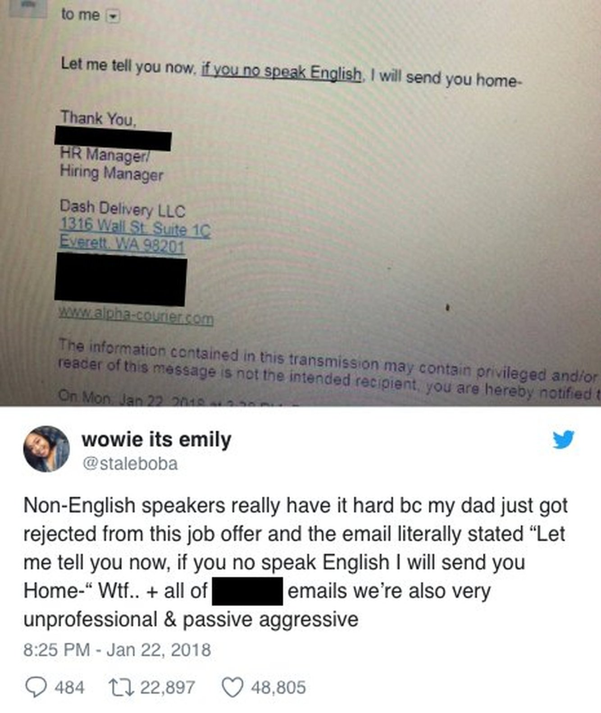
The Problem
Notes:
Intro - Personal Experience : Bullied at school for low english profiecieny.
Goal: improving confidence people’s lifes
Twitter post.
Personal:
Fourteenth years ago, I arrived to the United States from Lima-Peru knowing neither the language nor the culture. I vividly remember having a hard time communicating with my peers as I did not know a single word in English. As a young immigrant in the U.S I faced challenges such as ( bullying, depreciation..) led my my inability to communicate in English. This challenging experience I do not wish it upon anyone.
While I have personally experienced the challenges and want to help foreign born individuals… theyre are also cases of language discrimintion in the workforce. For instance an immigrant parent who applied to a job was told
This typr of discrimination should not occur.
With over 43.2 million foreign born population and latin american and mexican being the largest percentage of foreign born population with 52% ( 22.4mill) market. We are estimating spanish being the most spoken non- English language it is a large issue worth solving.
I posted this tweet as it shares the reality what non english speakers deal with.
A few months ago this happened… tweet went viral in January
An email went out that said “ let me tell you…..
This discrimination happens on a daily basis
My story: I grew up as a spanish speaker learning english as a second langauge.
Although today I am able to stand in front of you, this is due to my time and dedication of learning English
I know many are not as fortunate and thus

Slide 4

Stakeholder
Immigrant from Peru
Limited English
Has a part-time job
8 year-old Son
Fear/Embarrassment
Sofia | Female | 35
Notes:
The main pain point we are conbating is : Fear/ embarrassment : Completing daily day task such as
Focus: older group - in gneral is educational -
https://www.migrationpolicy.org/programs/data-hub/us-immigration-trends
http://www.pewhispanic.org/2015/09/28/chapter-5-u-s-foreign-born-population-trends/
https://nces.ed.gov/fastfacts/display.asp?id=96
# of surveys / people we pitched ;
# presented one college
survey/research results?
Stakeholders?
Confirming our problem
Direct quotes
Reinforce communication to learn
With over 43.2 million foreign born population and latin american and mexican being the largest percentage of foreign born population with 52% ( 22.4mill) market.
Sofia is part of the 4.3 mill individuals taking ESL classes in the US.
We interviewed 10 individuals from this background. We surveyed them and got 15 responses. There was a 94% positive correlation
30 berkeley community college.;

Slide 5
Market Cap
8.5 M
US spanish speakers not proficient in English
350 M
Spanish native speakers worldwide
18.92 M
US Spanish speakers
Notes:
There are many sofias in the US -
That needs the support for learning english.
43 M
US foreign born population

Slide 6
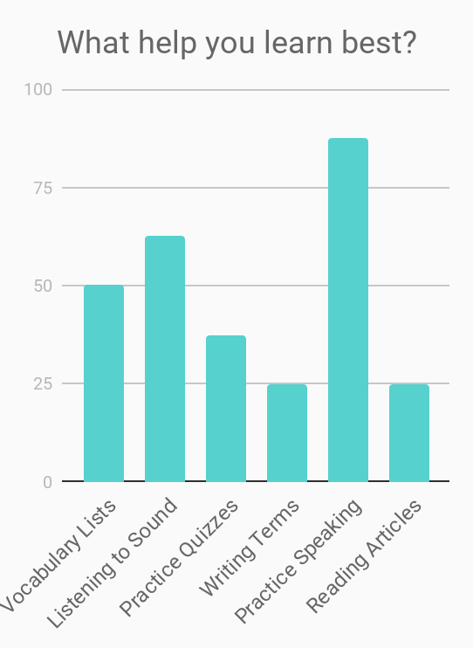
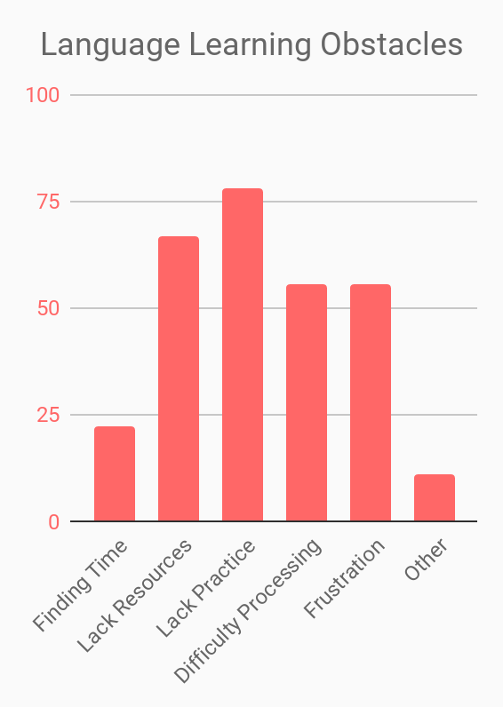
Survey Results
Notes:
Our team tested our hypothesis -
Ailean is a web platform for immigrant parents seeking to improve their English language skills through situational conversational modules to improve their job marketability and day to day situations. The United States of America currently houses a large population of immigrants who struggle with learning the English language. These individuals do not get the opportunity of upward social mobility, and are often discriminated against in the workforce. As a result of improving their English language proficiency, parents will provide greater educational and economical support for their children.
94% of the responses reinforce that practicing speaking is ideal to learn a new language.
Lack of practice and resources
There is a direct correlation between the lack of practice opportunities and the benefits of practicing speaking.

Slide 7



Our Solution
learn the conversations
you need
> fulfill immediate demands
conversational modules for urgent, practical situations E.g. doctor visits, job interviews
> speak confidently
ai+learn
real-time pronunciation accuracy
Notes:
Make it a step by step process
Step 1 - make an account and fill in language you know
Step 2: with with Ailean and get real time feedback
Step 3 - analytics, pronounciation accrurancy
Step 4: Improve, test, converse
Advice:
Focus on differentiating factors
New factors in market.

Slide 8
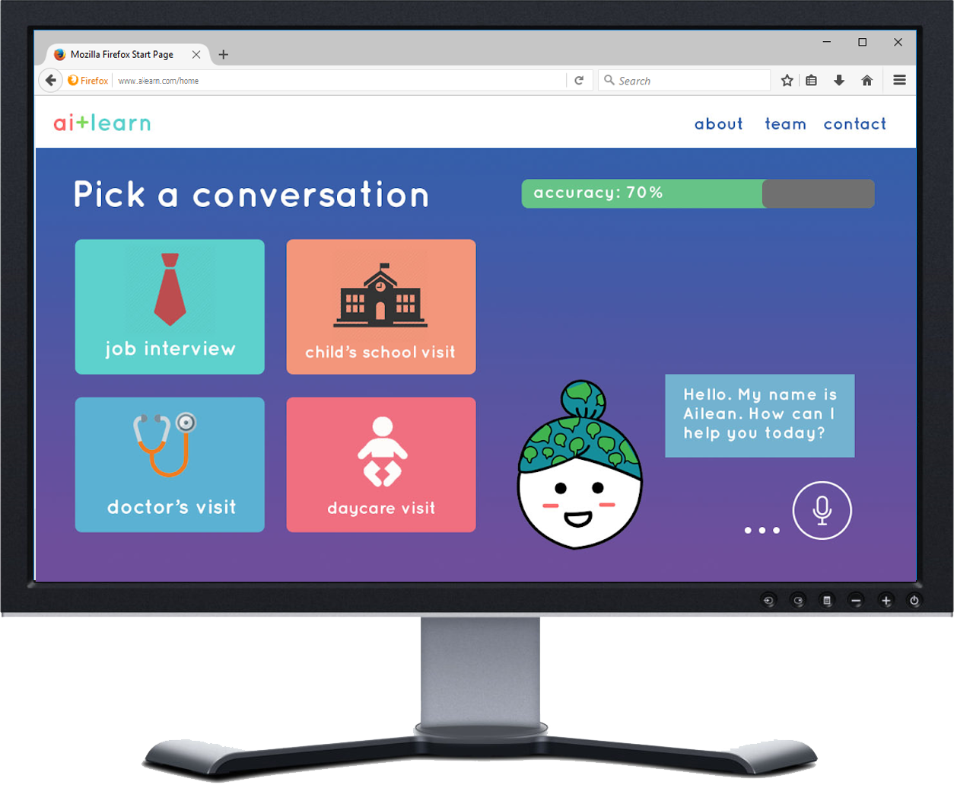
Our Solution
Get real-time feedback for pronunciation accuracy
Register & choose your language
Choose a situation & talk to Ailean!
Converse, improve, excel!
3
1
2
4

Slide 9




The Technology
Google Voice API / Siri Control
User speaks to Ai+Learn
Dictionary of modules containing command words & responses
Measuring pronunciation accuracy: sentence tokenization & comparison to existing sets
Google Translate API

Slide 10






Competitive Landscape
Practice Speaking
Real-Time Feedback
Accessible
Practical Modules
Verbal & Auditory
Notes:
Differentiation Factor: A next generation language learning platform incorporating new-age situational learning tactics to streamline the direct application process.
We target a market that has not reached out to before.
Language studies international
Litworld
What sets our products apart from others, it is the 5 differentiating factors that we have found are absent in the market:
Differentiation Factor: Incorporates AI learning technology and focuses on providing communication practice Simple User Interface (UI) Less time - situational learning Applicable learning ( Focus on getting a moderate understanding) Communication base Non- traditional Next generation language learning techniques. Utilizes cutting-edge personal assistant technology with education

Slide 11



B2B Connections
B2B
Organizations providing instruction in English as a second language
(Eg. community colleges, private institutes, adult schools)
Notes:
https://internationaloffice.berkeley.edu/esl_classes
List of english offerings
Connected to Berkeley city college
Direct connection with San mateo
Our platorm informs - conencting with organizations.
Why B2B - we have acknoleged that by doing a B2B it is easier to reach our target population.
Subscription model
28 locations in the Bay area

Slide 12
Business Model
U.S. Colleges/ Institutions
ESL Classrooms per College
6-month Access
$675 x 15 x 1,462
= $15 Million
Notes:
Subscription model fit for Community College
25* $30 * .90 - 6 month access for a course.
http://www.berkeleycitycollege.edu/wp/esl/files/2015/10/BCC-ESL-SLOsNCF15.pdf
15 classes offered at berkeley for ESL program.

Slide 13
Why us?
1000 dollars in funding from Cal Hacks
8 Months of in depth experience
3 Dedicated co founders
1 Mission

Slide 14
Our Asks
Advice/mentorship on how to approach current translational, machine learning, and artificial intelligence resources
Contracting Developers to kickstart and further the exploration for the future of ai+Learn
Notes:
More especific?

Slide 15
Questions?
Feel free to contact us!
Julie Lum julielumy@berkeley.edu
Katherine Necochea Tinco: knecochea@berkeley.edu
Jacqueline Angelina jacqueline.angelina@berkeley.edu

